Slide 1






Smart Intrusion
Prevention
System
Presented By:
Chandrahaas
Rakesh
Yohannh David
Sharath Naik
Narahari

Slide 2

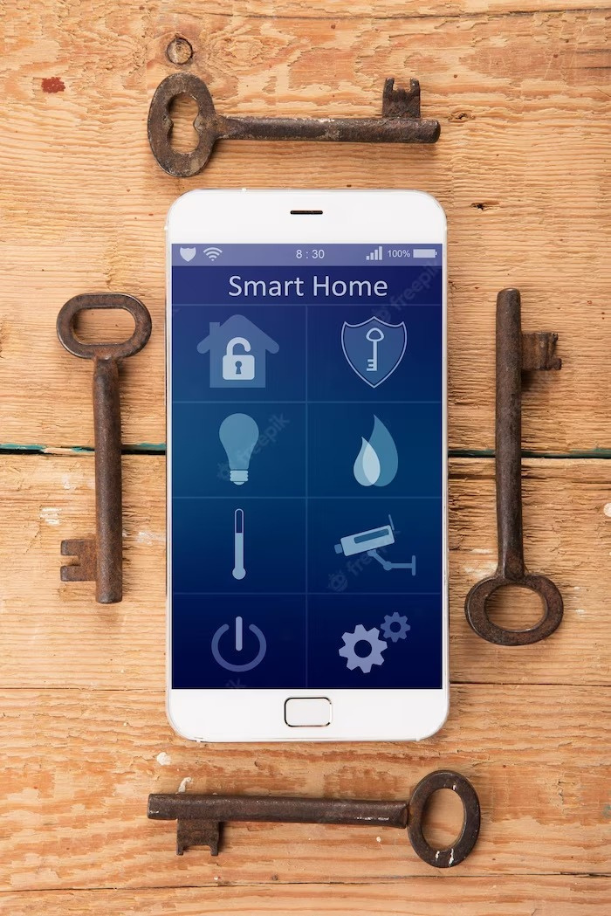
Introduction
A human intrusion detection system is designed to detect an unauthorized entry into a building, shops or a protected area and deny such unauthorized access to protect personnel and property from damage or harm. This system provides proper detection of intruder and provides security. By using this system, we can reduce robbery by detecting the intruder. So we can respond quickly such that no harm takes place in our home.

Slide 3

Understanding Intruder Prevention Systems
These systems are designed to detect, deter, and prevent unauthorized access to a property or premises. We can use advanced technologies such as motion sensors and cameras to make intruder prevention systems more efficient.

Slide 4
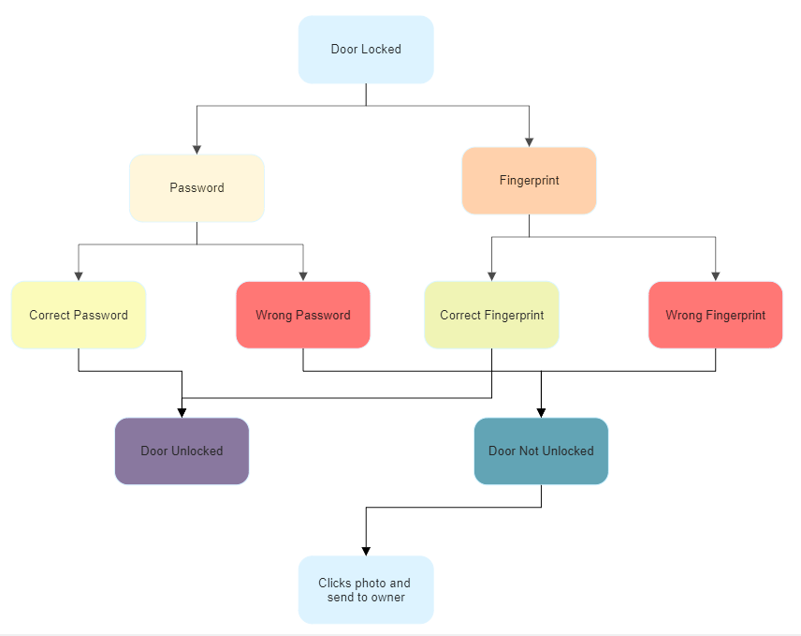
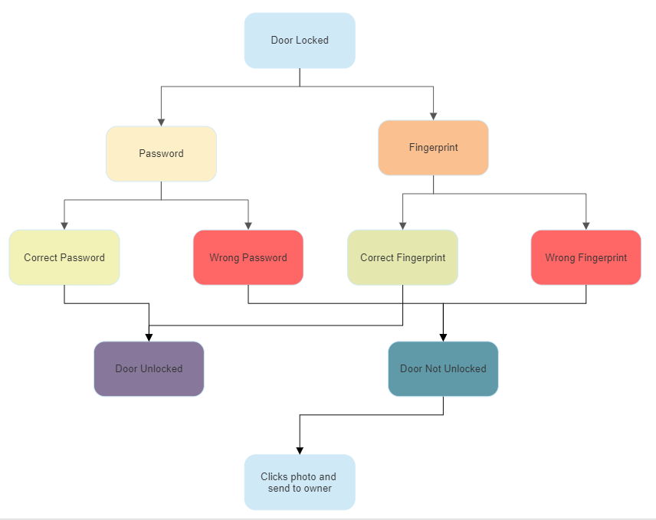
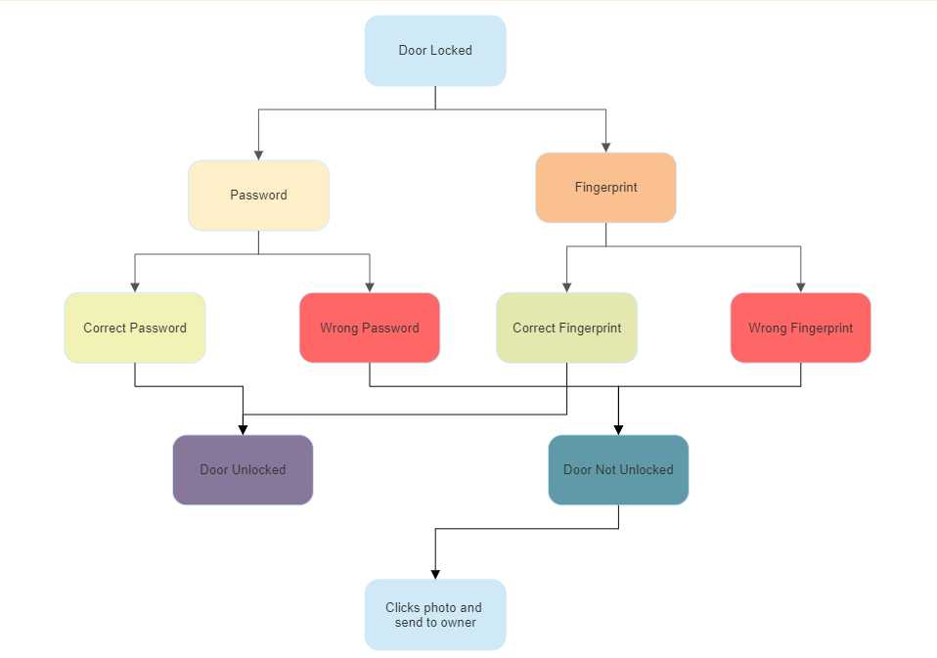
FLOW CHART

Slide 5
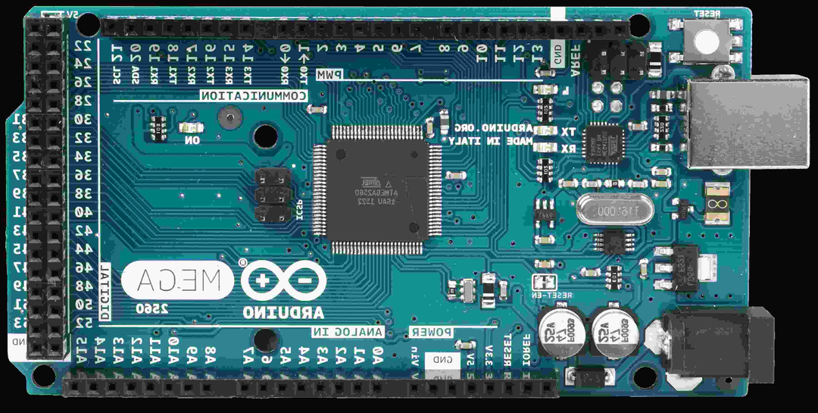
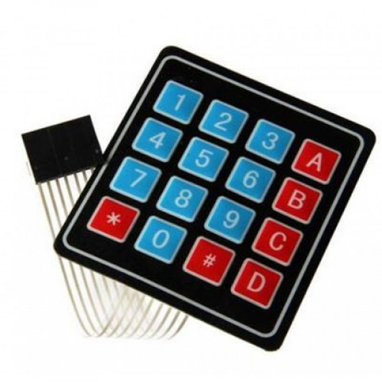
Components Used
Arduino Mega 2560
To store the code and perform the functions
4x4 Keypad
For entering code to unlock

Slide 6
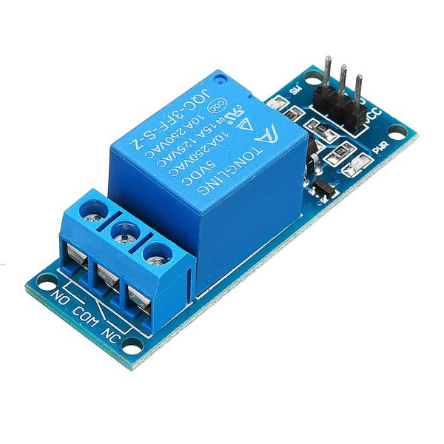
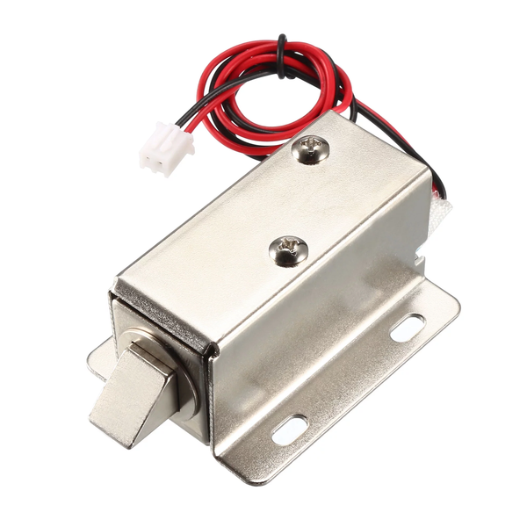
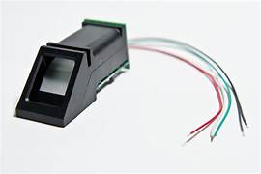
Components Used
Relay
Used as switch to control Solenoid lock
Solenoid Lock
Digital lock that looks like traditional door lock
Fingerprint Sensor
To unlock the door using fingerprint

Slide 7
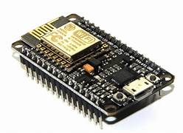
Components Used
Nodemcu(ESP32)
To connect Arduino to internet through which
lock can be opened

Slide 8
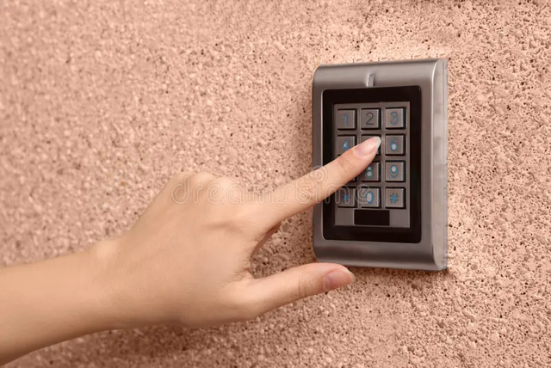


WORKING
Using Passcode
Using Fingerprint
Using Mobile Application

Slide 9
Q&A

Slide 10
Thank You!

